Slide 1
THE EVOLUTIONARY IMPLICATIONS OF KINSHIP TIGHTNESS
Carol R. Ember
Anj Droe
Danielle Russell with
Benjamin Gonzalez and Daniel McCloskey
Presented at the annual meeting of the American Anthropological Association, Seattle, WA, November 9-13, 2022

Slide 2
Anthropologists often speak of the web of kinship as providing the main structure of social action in non-commercial societies.
But some kinship systems are much more extensive than others and play more of a role in everyday life.
Why the variation?

Slide 3
What do we mean by kinship tightness?
Refers to the degree to which people are embedded in large, interconnected extended family networks (Enke 2019).
Tightness is expected to be greater when
  Core members live together in contiguous space; the larger the group, the more tight
  Relationships are clearly specified and tracked
  Kin groups have more functions and kin group members occupy important societal roles
Notes:
As Benjamin Enke (2019) defines it, kinship tightness reflects “the extent to which people in preindustrial societies were embedded in large, interconnected extended family networks” (957).

Slide 4
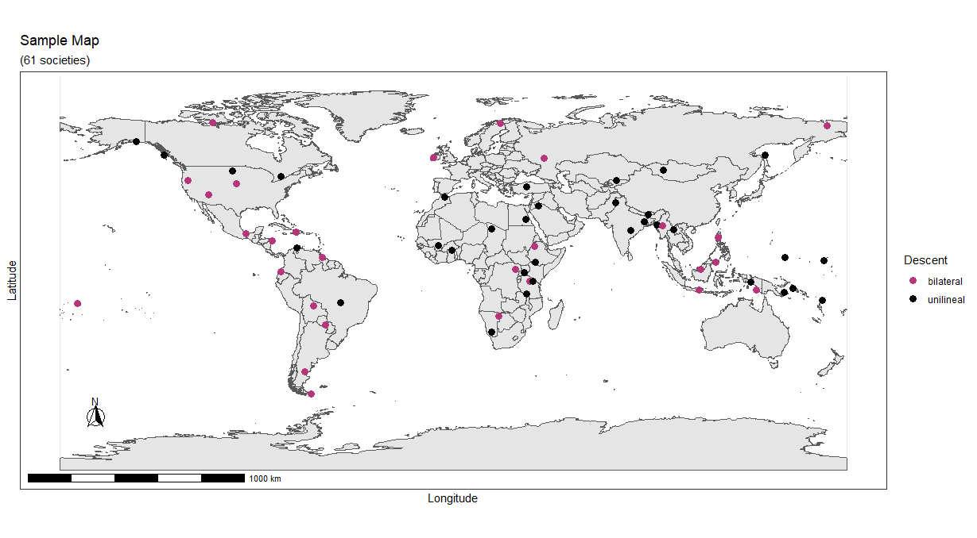
OUR SAMPLE
Notes:
Our starting sample was the 98 societies previously coded for our grant project (see Acknowledgements), Sixty-one of those societies were identified as having either unilineal descent or bilateral descent.

Slide 5
Constructing a measure of kinship tightness
We made some fundamental assumptions:
  Living with or near kin is critical to kinship tightness; non-neolocal residence gives a minimal kinship structure
  Since kin cannot operate as a corporate group in bilateral systems, we consider them less tight than unilineal kinship systems.
  Unilineal kinship is most variable because kin groups can be very deep or shallow, trace precise ancestry or not, and live contiguously or not.
For clarity, we have omitted societies with ambilineal kinship and double descent.

Slide 6
New Variables Coded for Unilineal Descent
Number of levels of kin group
For each level of kin group we rated
  Whether ancestry is traced
  Whether core members live contiguously
  Functions held by each level of unilineal kin group which included
    Regulating marriage
    Holding property, mutual aid or other economic functions
    Having political functions (as leaders, kin-based council, conducting offense or defense).
    Performing religious functions and roles
    Non-religious ritual or ceremonial functions
    Other functions

Slide 7
Are there any latent factors for unilineal kinship tightness?

Slide 8
Latent
Factor for unilineal kinship
 | PC1 | PC2 | PC3
% variance explained | 0.749 | 0.154 | 0.098
Ancestry | 0.591 | -0.391 | -0.706
Contiguity | 0.550 | 0.835 | -0.003
Political Leader | 0.591 | -0.386 | 0.708
Results of a principal components analysis; the PC1 scores were used as our main measure of unilineal kinship tightness
Notes:
We used a principal components analysis that considered 12 different measures of unilineal kinship tightness. After dropping variables that loaded less than .40 on the first principal component, we redid the principal component analysis with the variables shown above. The revised PC1 score was considered a latent factor that we could use to measure kinship tightness. It explained 75% of the variance; It is also significantly correlated with the number of levels and the number of functions.

Slide 9
Overall kinship tightness scale
Kinship Tightness Coding Criteria | Code label | Cases
Bilateral and neolocal or bilocal | 1 | 11
Bilateral and non-neolocal (has alternative residence) | 2 | 11
Bilateral and unilocal (no alternative residence) | 3 | 6
Unilineal PC1 scores in the first quartile (-1.96 to -1.13) | 4 | 6
Unlineal PC1 scores in the second quartile (-1.12 to -0.39) | 5 | 9
Unilineal PC1 scores in the third quartile (-0.38 to 1.18) | 6 | 9
Unilineal PC1 scores in the fourth quartile (1.19 to 4.45) | 7 | 9
To produce an overall kinship tightness scale we divided the PC1 scores into quartiles (last four rows) and combined it with a bilateral scale of kinship tightness
Notes:
We have three different tightness scores for bilateral kinship depending on the degree of unilocality. Unilocal residence should have more tightness than unilocal residence with an alternative and neolocal or bilocal residence should have the least. This is reflected in rows 1-3.

Slide 10
Results
Predictors of Overall Kinship Tightness
Correlates:
Mid-range societal complexity
Overall cultural tightness
Notes:
For societal complexity we used the summary measure of 10 different aspects of complexity from Murdock and Provost (1973). Indeed, as expected and as we see in the next slide, kinship tightness is generally greatest in societies with mid-range societal complexity.
Overall cultural tightness as measured by the presence of strong norms and a low tolerance of deviant behavior (Jackson, Gelfand, and Ember 2020) also predicts kinship tightness, but as we discuss shortly, we believe that kinship tightness is more likely to produce overall tightness than the other way around.

Slide 11
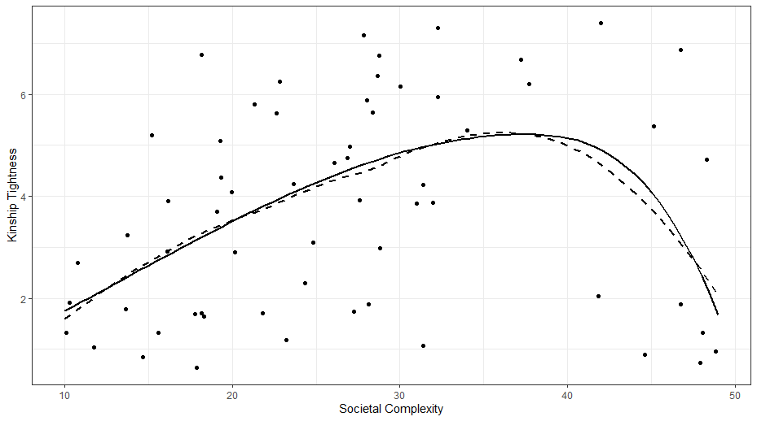

Slide 12
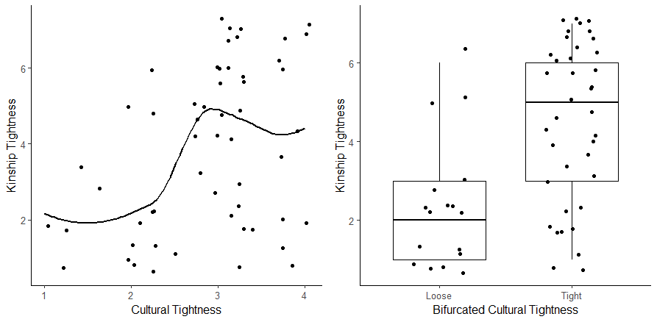
Notes:
Figure XX: Cultural Societal tightness predicting kinship tightness. The left image uses the full societal tightness scale and the right image depicts culturalsocietal tightness bifurcated at 2.7 and lower.
the relationship ON THE LEFT is significant with Rho = 0.34 (p<=0.01; n=55; See left side of Figure), but the relationship looks somewhat curvilinear with a plateau at about 2.7. If we divide the TL variable at at less than or equal to 2.7 (loose) versus greater than 2.7 (tight), the relationship becomes stronger with Rho = 0.49 (p<=.0001).

Slide 13
Results
Predictors of Overall Kinship Tightness
Possible Causes
unilocal residence*
warfare
food shortage
*In comparisons with unilocal residence, the overall kinship tightness scale was truncated so that all bilateral cases were merged into the lowest position.
Notes:
Unilocal residence has long been considered an important predictor of unilineal descent because the core group of what would be unilineal members live contiguously if unilocal residence is present. However, it is not sufficient since many unilocal societies lack unilineal descent. What additional predictors may be important?

Slide 14
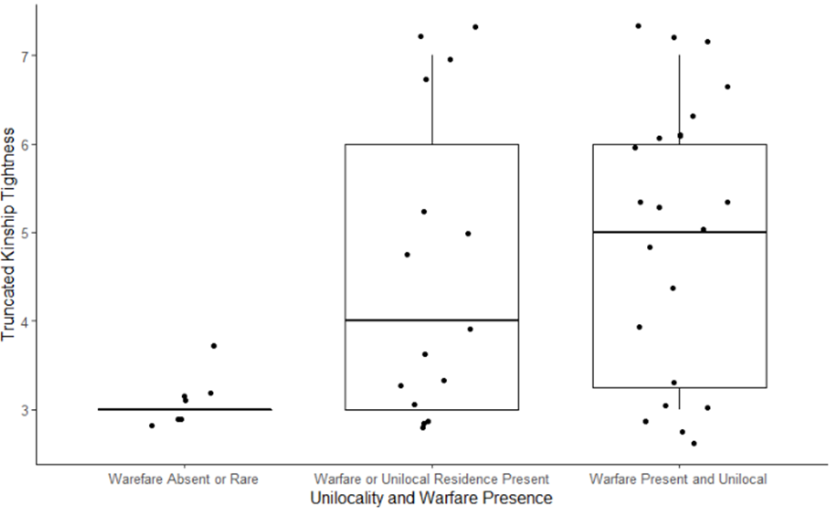
Notes:
Building on the work by Service (1962: 117) and Sahlins (1961), Ember, Ember and Pasternak (1974) proposed and presented evidence supporting the theory that the presence of warfare is an important catalyst for the formation of unilineal descent in unilocal, particularly nonstate societies. Ember et al. point out that in contrast to bilateral kinship, characterized by overlapping kindreds, unilineal descent groups provide an unambiguous and discrete set of kin that can be called upon for offense and defense.
Although Ember et al. were explaining the presence of any unilineal descent, the presumption would be that the combination of unilocal residence and some warfare would also predict kinship tightness. The average kinship tightness score (the horizontal line) is highest when both conditions are present and lowest when neither is present.

Slide 15
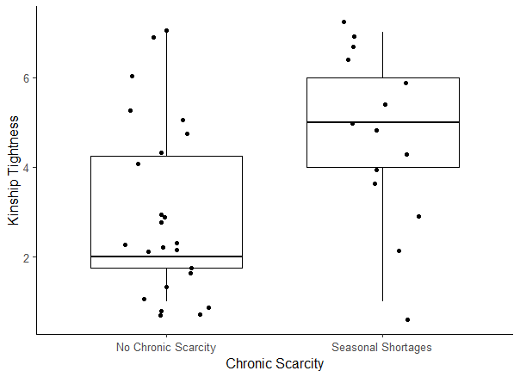
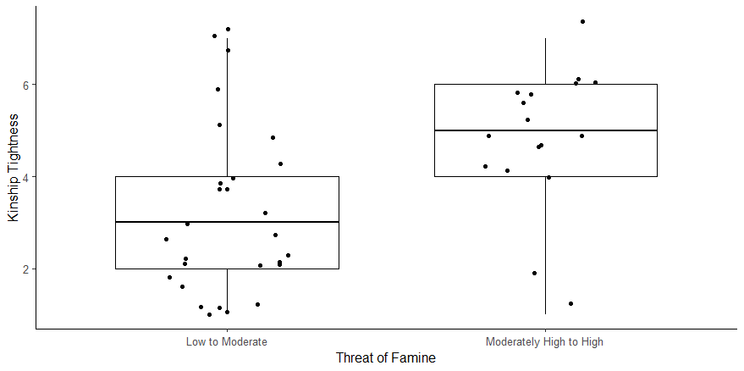
Resource Stress Predictors
Notes:
Kin groups not only can provide assistance in offense and defense, they can also provide mutual assistance. This suggests that resource stress may predict more kinship tightness. Indeed, two measures of resource stress--chronic seasonal shortages and moderately high or high threat of famine--predict more kinship tightness.
While previous research on sharing by Ember et al. 2018 found that beyond-household food sharing is higher with more resource stress, resource stress predicts less sharing with non-relatives. The implication is kinship relationships provide a critical context during difficult times.

Slide 16
Results
Predictors of Overall Kinship Tightness
Consequences:
more authoritarianism
more community institutions
Notes:
Our results are consistent with Jackson et al. (2020) who found societal tightness significantly predicted more authoritarian leadership at the community level. Tighter kinship as we measure it here also predicts tighter kinship.
Our results are also consistent with Enke who found a positive relationship between kinship tightness and village-level institutions. We estimate the correlation to be rho = .31 (p< .05; n = 61). [inset theory about village-level institutions]

Slide 17
Evolutionary implications
eán
Notes:
As many theorists have surmised, living with or near one set of kin by virtue of a rule of residence facilitates the formation of unilineal kinship and makes tighter kinship structures more likely. But it is likely that in mid-range societies without centralized polities that kinship solutions form the most likely responses to socio-ecological threat. We have found here that independent of other control variables, more frequent war and higher frequency of famine predict greater kinship tightness. We also suggest that it is kinship tightness that generalizes to general cultural tightness, not the other way around.
Unlike Enke’s findings, we did not find a negative relationship with moral high gods and tighter kinship, not significantly higher in-group favoritism.

Slide 18
Acknowledgements
Kinship tightness coding was primarily by Ben Gonzalez and Daniel McCloskey with some additional coding by Anj Droe and Danielle Russell.
This research was supported in part by the National Science Foundation (NSF Interdisciplinary Behavioral and Social Science Research (IBSS) grant no. SMA-1416651, IBSS: Natural Hazards and Cultural Transformations and more recently by a Minerva Research Initiative Grant titled ”Response to Shocks and Hazards Associated with Climate.” The Human Relations Area Files has also provided support.

Slide 19
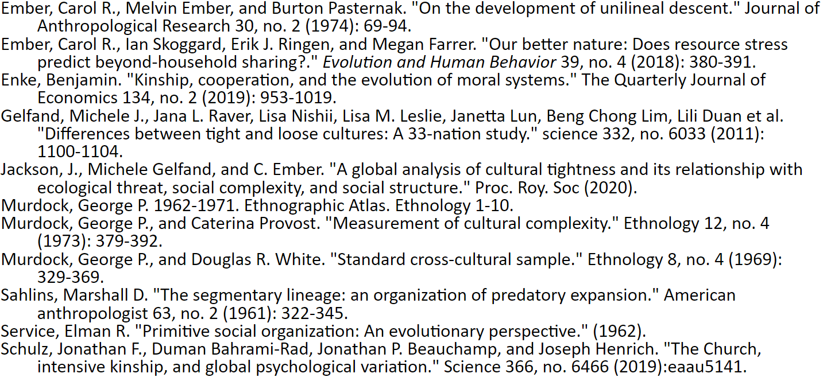
REFERENCES

